Slide 1
Unit-IV Switching and Routing

Slide 2
Routing
Routing is the act of moving information across an inter-network from a source to a destination.
It’s also referred to as the process of choosing a path over which to send the packets.

Slide 3
Classification of Routing:
Static versus Dynamic
Single-path versus multi-path
Intra-domain versus inter-domain
Flat versus hierarchical.
Link-state versus distance vector
Host-intelligent versus router-intelligent.

Slide 4
Routing algorithm Metric:
Various metrics of routing algorithm are:
Path length
Delay
Bandwidth
Load
Communication cost
Reliability

Slide 5
Routing Protocols
Static Routing
Dynamic Routing
Interior Gateway Protocols (IGPs)
Exterior Gateway Protocols (EGPs)

Slide 6
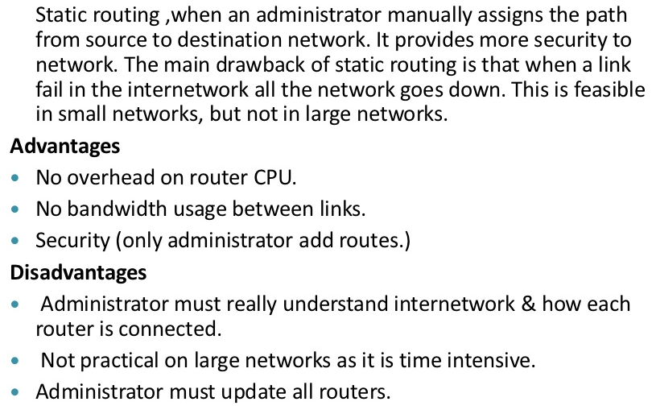
Static Routing Protocols

Slide 7
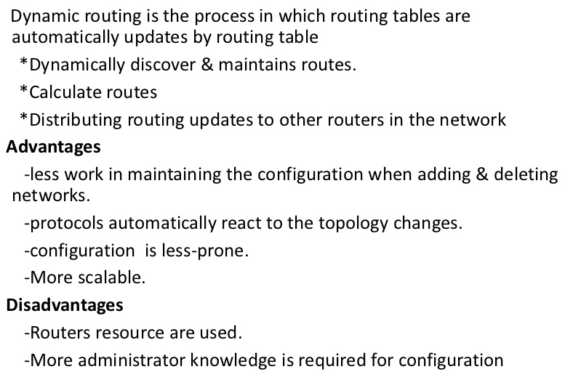
Dynamic Routing Protocols

Slide 8
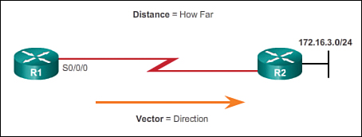
Distance Vector Routing Protocols
Distance vector means that routes are advertised by providing two characteristics:
Distance: Identifies how far it is to the destination network and is based on a metric such as the hop count, cost, bandwidth, delay, and more
Vector: Specifies the direction of the next-hop router or exit interface to reach the destination

Slide 9
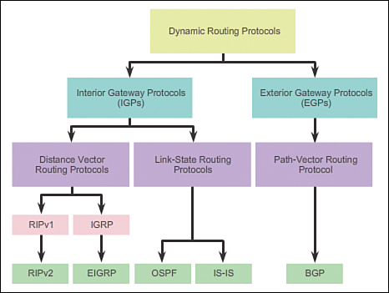

Slide 10
Distance Vector Routing or Bellman Ford Algorithm is a type of algorithm used by routing protocols to learn routes on an interconnected network. Routing protocols that use distance-vector routing protocols include:
1. Routing Information Protocol RIP.
2. Cisco's Internet Gateway Routing Protocol IGRP.
3. Apple's Routing Table Maintenance Protocol RTMP.
In distance vector routing when a router is booted it maintains a routing table advertising vector of distance and direction. Direction is represented by next hop address, whereas Distance uses metrics such as hop count.
After every fixed period of time router exchanges its routing table with its neighbouring router and we get a new merged table.

Slide 11
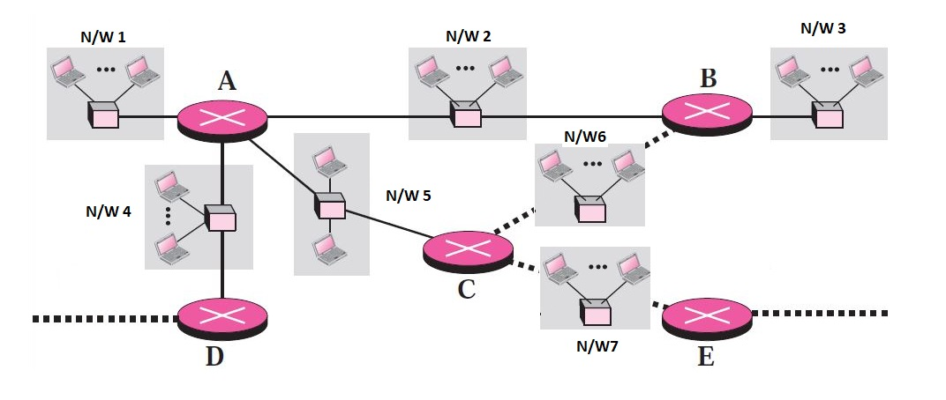
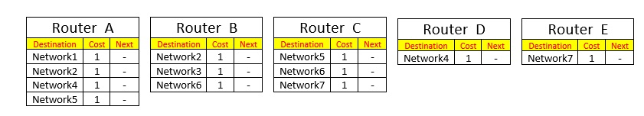
When Routers are booted Routers gathers information from attached networks and maintains following routing tables:

Slide 12
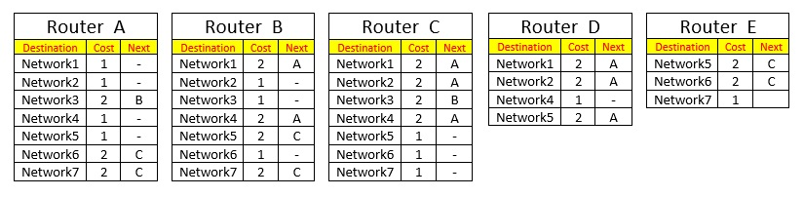
After a fixed period of time routing tables of the neighbouring tables are shared:
Router A swaps its information with Router B , Router C and Router D.
Router B swaps its information with Router A and Router C
Router C swaps its information with Router A, Router B and Router E
Router D swaps its information with Router A
Router E swaps its information with Router C

Slide 13
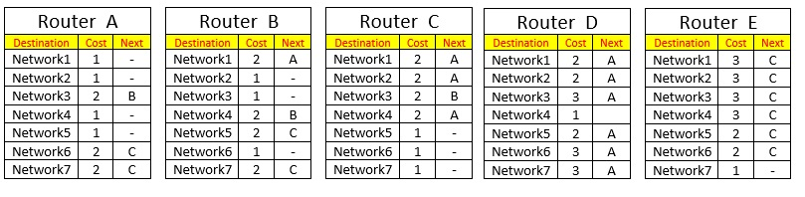
After a fixed period of time updated routing tables of the neighbouring tables are shared:
Router A swaps its information with Router B , Router C and Router D.
Router B swaps its information with Router A and Router C
Router C swaps its information with Router A, Router B and Router E
Router D swaps its information with Router A
Router E swaps its information with Router C
Note: See example of Bellman Ford Algorithm.

Slide 14
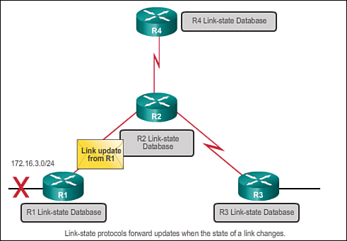
Link-State Routing Protocols
Router configured with a link-state routing protocol can create a complete view or topology of the network.
This is done by gathering information from all of the other routers.
Link-state update is only sent when there is a change in the topology

Slide 15
Link-state protocols work best in situations where:
The network design is hierarchical, usually occurring in large networks.
Fast convergence of the network is crucial.
The administrators have good knowledge of the implemented link-state routing protocol
There are two link-state IPv4 IGPs:
OSPF: Popular standards-based routing protocol
IS-IS: Popular in provider networks

Slide 16
Open Shortest Path First (OSPF)
Open Shortest Path First (OSPF) is another Interior Gateway Protocol. OSPF was created because the Routing Information Protocol (RIP) was increasingly incapable of serving large inter-networks.
OSPF is based on the Shortest Path First algorithm, which is also referred to as the Dijkstra’s algorithm.
OSPF is a link-state routing protocol as it sends state of all other routers.
This protocol is open, which means anyone can implement it without paying license fees.
It supports both IPv4 and IPv6 routed protocols.
There are certain disadvantages of OSPF also, it requires extra CPU process to run SPF algorithm, it requires more RAM and is more complex to setup and hard to troubleshoot.

Slide 17
Link State of can be measured using following metrics:
Measuring link utilization
Number of hops (hop count)
Speed of the path
Packet loss (router congestion/conditions)
Latency (delay)
Path reliability
Path bandwidth
Throughput
Load on link
MTU maximum transmission unit
Note: See the pdf file for the numerical example of Djkstra algorithm

